Slide 1
Rasp
berry
pi

Slide 2
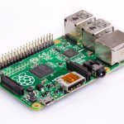
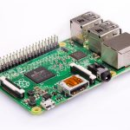
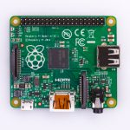
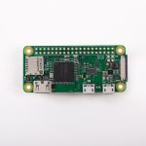
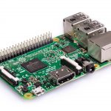
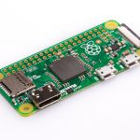
Models
Raspberry pi 1 Model B+
Raspberry pi 2 model B
Raspberry pi 3 model B+
Raspberry pi 3 model B
Raspberry pi zero
Raspberry pi zero W

Slide 3
Raspberry pi 3 [specifications]
Quad Core 1.2GHz Broadcom BCM2837 64bit CPU
1GB RAM
BCM43438 wireless LAN and Bluetooth Low Energy on Board
40 – pin extended GPIO
4 USB 2 ports
4 pole stereo output and composite video port

Slide 4
Specifications continued..
Full size HDMI
CSI camera port for connecting a Raspberry pi camera
DSI display port for connecting a raspberry pi touchscreen display
Micro SD port for loading your operating system and storing data
Micro SD port for Upgraded switched Micro USB power source up to 2.5A

Slide 5
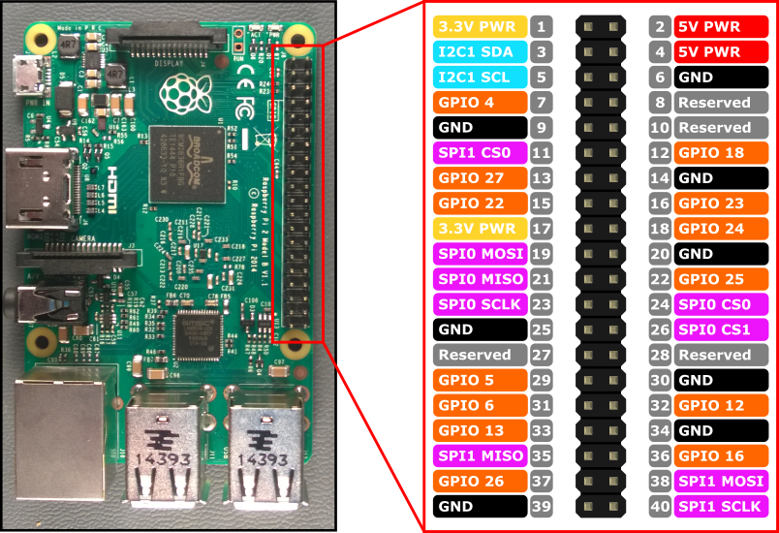
Raspberry pi 3 [pinout]

Slide 6
Raspberry pi zero W [specifications]
802.11 b/g/n wireless LAN
Bluetooth 4.1
Bluetooth Low Energy (BLE)
1GHz, single-core CPU
512MB RAM

Slide 7
Raspberry pi zero W[specifications]
Mini HDMI and USB On-The-Go ports
Micro USB power
HAT-compatible 40-pin header
Composite video and reset headers
CSI camera connector

Slide 8
Practical session[Controlling the pi from a web server]
Prerequisites
A breadboard
Raspberry pi
Jumper wires
2 resistors
2 LED’s
A power source

Slide 9
Knowledge check
Understanding what a block of code would mean (python)
GPIO pins
Sensor integration

Slide 10
Process [connections]
Working with the pi zero [connections]
Working with the pi3

Slide 11
Process [software]
Virtual environments
sudo pip install virtualenv virtualenvwrapper
sudo rm –rf ~/.cache/pip
export WORKON_HOME=$HOME/.virtualenvs
source /usr/local/bin/virtualenvwrapper.sh

Slide 12
Virtual environments cont..
echo -e "\n# virtualenv and virtualenvwrapper" >> ~/.profile
echo "export WORKON_HOME=$HOME/.virtualenvs" >> ~/.profile
echo "source /usr/local/bin/virtualenvwrapper.sh" >> ~/.profile
source ~/.profile
mkvirtualenv cv -p python2

Slide 13
Flask
Sudo apt-get install python-pip python-flask
Sudo pip-install flask

Slide 14
Organization
----python code ---
mkdir [name]
cd [name]
Sudo nano [filename]
---- web server -----
Mkdir templates
Cd templates
Sudo nano [filename2]

Slide 15
Test
Cd ..
Sudo python name.py

Slide 16
On your web browser
http://IPADDRESS

Slide 17
Applications
Automatic actuation – the case of automatic irrigation

Slide 18
Questions & Comments

